Slide 1
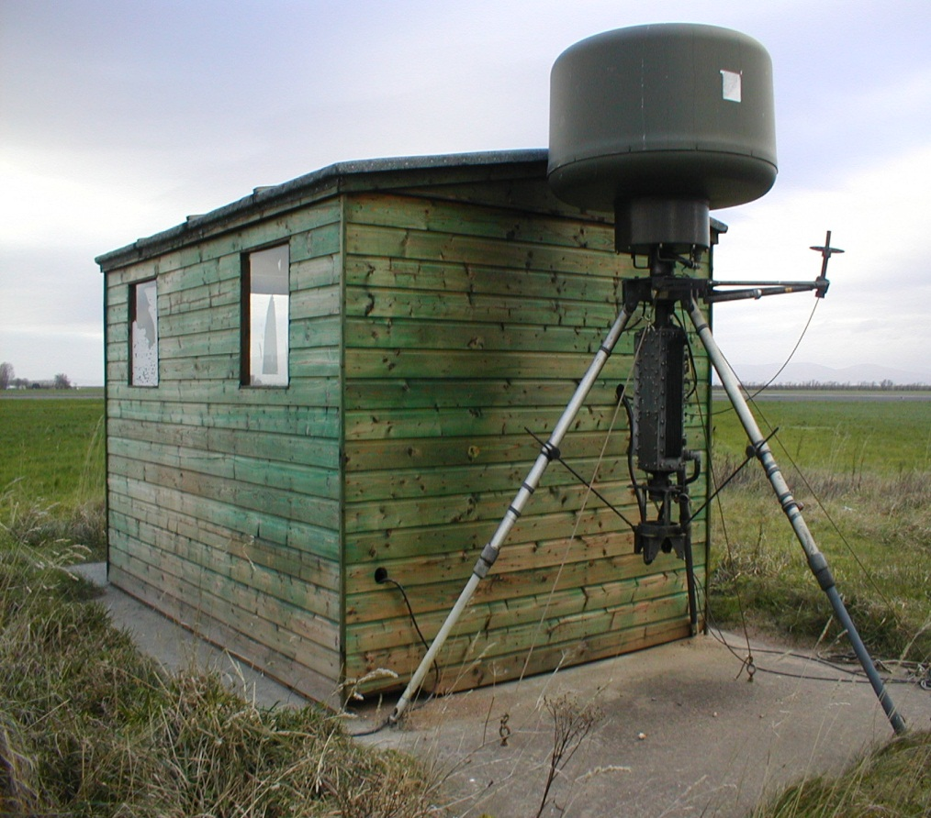
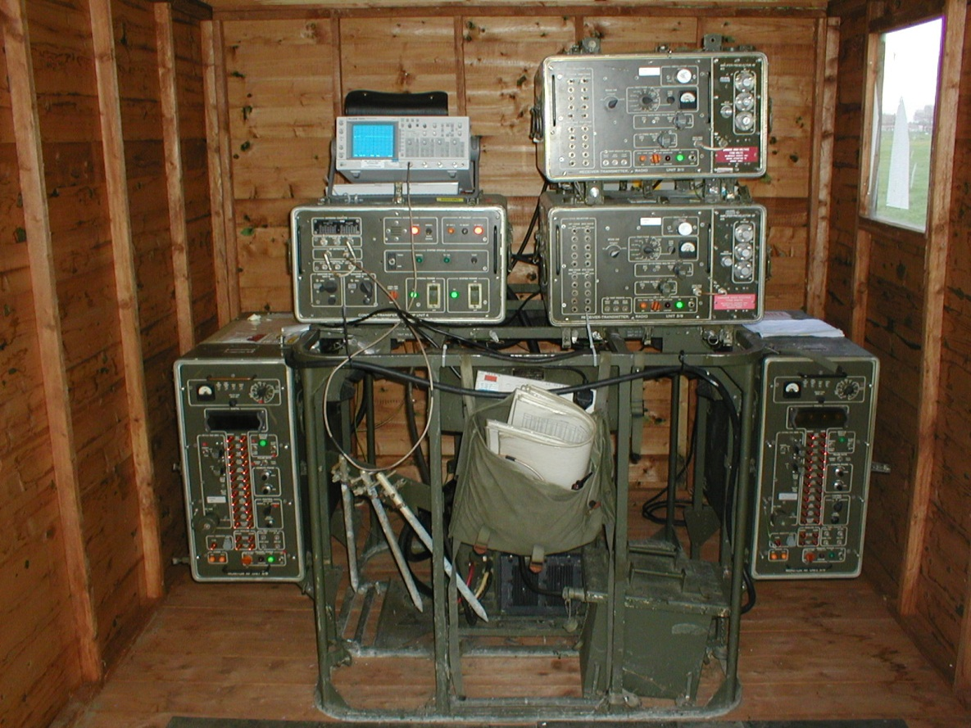
TACAN

Slide 2
Tacan TRN 26
TACAN is an airfield navigation aid designed to give aircrew:
  Bearing,
  Range and
  Identity Information
  within approx. 100nm of the airfield.

Slide 3
Concise Details
Range approx 100 miles
Peak output power approx 450W

Slide 4
Purpose
TACtical
Air
Navigation
TACAN
Notes:
Slide 3
(1) & (2)
Imagine A/C takes off for an air combat sortie
After an hours dog fighting pilot needs to know where the airfield is
Draw A/C and airfield on board
What info does the pilot need to get him back to his airfield?
Where is the airfield – Direction
How far away is it – Distance
Is it his airfield – Identity

Slide 5
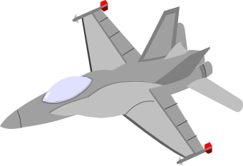
Purpose
Magnetic north
Range
Bearing to beacon
TACAN beacon
Notes:
Pilot gets Bearing of the Beacon from the A/C
ie – the Bearing A/C has to fly to get to the Beacon

Slide 6
Bearing Principles
Reflector
Aerial
Signal strength
E S W N E S W

Slide 7
Antenna Speed
Revolutions per minute = 900
Revolutions per second = 15
Bearing accuracy is +/- 2°
Notes:
(1) (2)
Frequency of the sine wave representing signal strength is 15Hz
It’s the phase of the 15Hz signal wrt the Main Ref Burst that represents the bearing of the A/C
It’s the number of degrees between the MRB and the 1st +ve cross-over
(3) (4)
Accuracy of ± 2° give an error of 3.5 nm at 100 miles (100 tan 2 = 3.5)
Is this error acceptable?
No
How can we increase the bearing accuracy of Tacan?
Increase the number of lobes – increases the number of cross-over points
How can we increase the number of lobes?
Speed up aerial
But aerial can’t physically rotate any faster

Slide 8
Range
The Tacan distance measuring equipment (DME) employs Secondary radar techniques

Slide 9
Range
Interrogations
Replies

Slide 10
Range
Aircraft calculates range using the following method:
Time between interrogation & reply - 50μS / 12.36μS
This calculation provides the aircrafts slant range

Slide 11
Aircraft Interrogations
The aircraft initially interrogates the beacon at:
100 pp/sec with a pre-determined pulse spacing
This is known as Search Mode
Tacan receives and decodes the pulse pairs then transmits reply pulses

Slide 12
Aircraft Interrogations
After receiving 60% replies to its interrogations:
Aircraft interrogations reduce to 25pp/sec
This is known as Lock Mode

Slide 13
Aircraft Handling Capability
The number of aircraft in Search Mode the beacon can handle is:
27
The number of Locked On aircraft the beacon can handle is:
Approx 100
Notes:
So knowing we have to maintain 2700pp/sec between our reference bursts, how many A/C can the beacon handle in Search Mode?
2700 ÷ 100 = 27
(1)
And the number in Lock Mode?
2700 ÷ 25 = 108
(2)
The number is realistically 100 due to the possibility of A/C interrogating the beacon in Search Mode at the same time

Slide 14
Identity
Beacon identity produced every 37.5 seconds
Uses morse code signal
  1/8 sec for a dot
  3/8 sec for a dash
  1/8 sec for a bit space
  3/8 sec for a character space

Slide 15
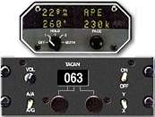
Aircraft Equipment
Used for military aircraft (UHF)
Aircraft has a TACVOR
VOR - VHF Omnidirectional Range navigation system

Slide 16
Objectives
By the end of this lesson the student should be able to:
State the purpose of Tacan
State the principles of operation of Tacan

Slide 17
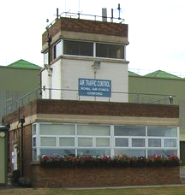
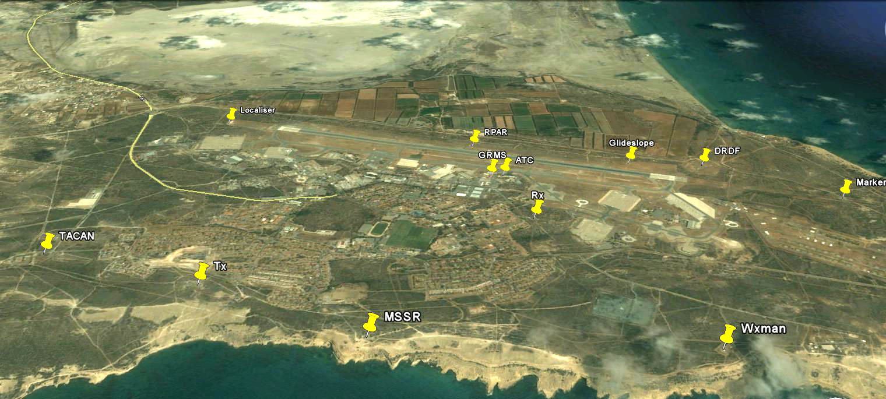
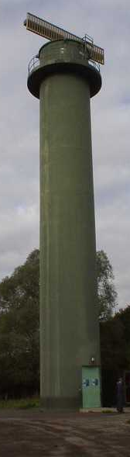

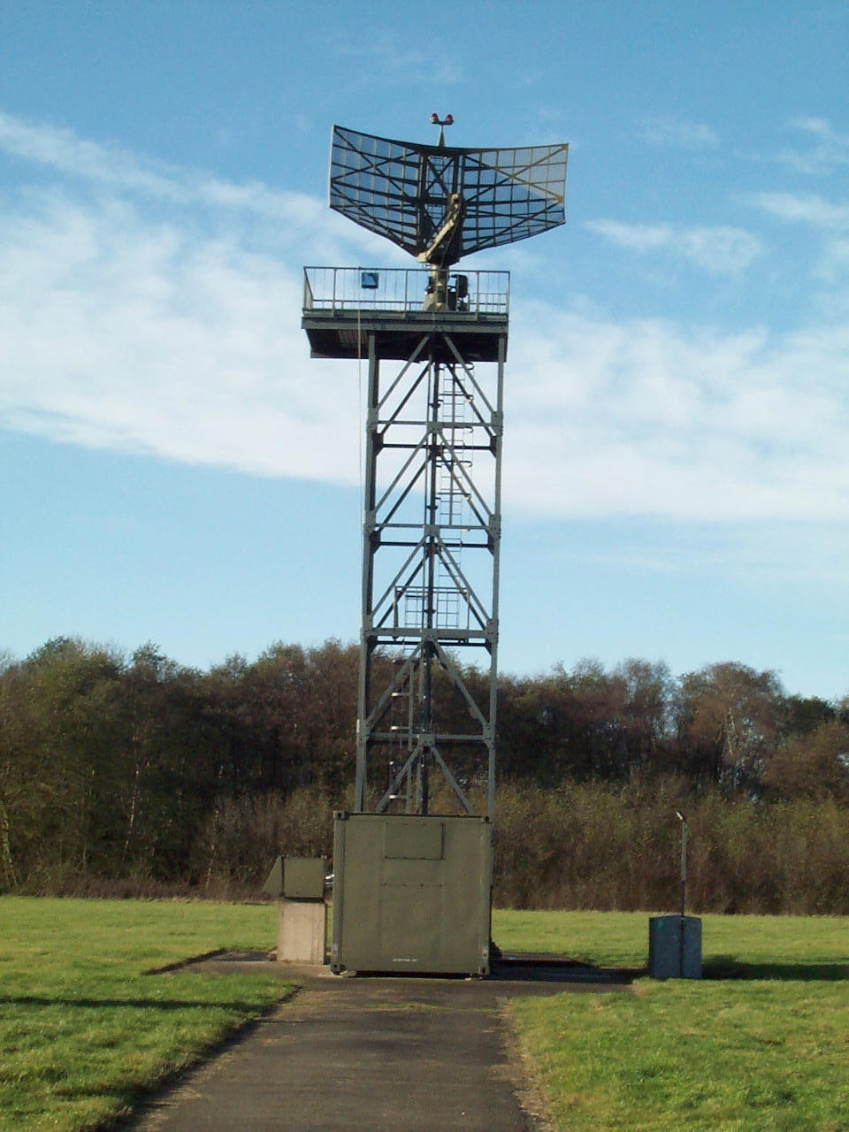
Airfield layout

Slide 18

Any Questions?
Notes:
1. What is the range of the standard Crown Watchman Radar? (A: 60Nm)
2. What Frequency Band does the Radar Operate on? (A: S Band or NATO E/F – 2 to 4GHz)
3. What is the “Uniform” PRI in µs? (A: 909 µs)
4. Why do we normally use “Staggered PRFs”? (A: To overcome the effects of Blind Speeds)
5. Our transmitter configuration is described as MOPA – What is MOPA and Describe it? (A: MOPA= Master Oscillator Power Amplifier, We use a 70MHz Oscillator and a TWT Power Amplifier).
6. What are the 2 advantageous characteristics of the TWT that causes us to use it? (A: It is a “Wideband” amplifier, that operates with a high degree of “Stability” across the frequency range)
7. What is the approximate PEAK output power of the Watchman? (A: 50 to 55kW)
8. What are the 2 pulse lengths of the Short Pulse and Long Pulse? (A: 0.4 µs and 20 µs)
9. How often are the 2 frequencies (F1 and F2) swapped in “Diversity“ mode? (A: Every 9 PRIs)
10. Why do we use 2 horns on the Watchman System? (A: We use 2 Rx beams, Main and Aux – The Aux beam just looks at the first 17Nm and is pointed slightly upwards to eliminated close-in ground clutter; The Main beam is selected for the remainder of the 60Nm range)
11. What is the approximate Azimuth Beamwidth at the 3dB points? (A: 1.5°)
12. What is the rotational Speed of the Aerial? (A: 15 rpm)
13. Give me 2 functions of the Signal Processing Rack (SPR) (A: 1. Houses Tx Driver and Receiver; 2. Carries out Signal Processing for the System; 3. Performs system timing and control functions)

